Slide 1
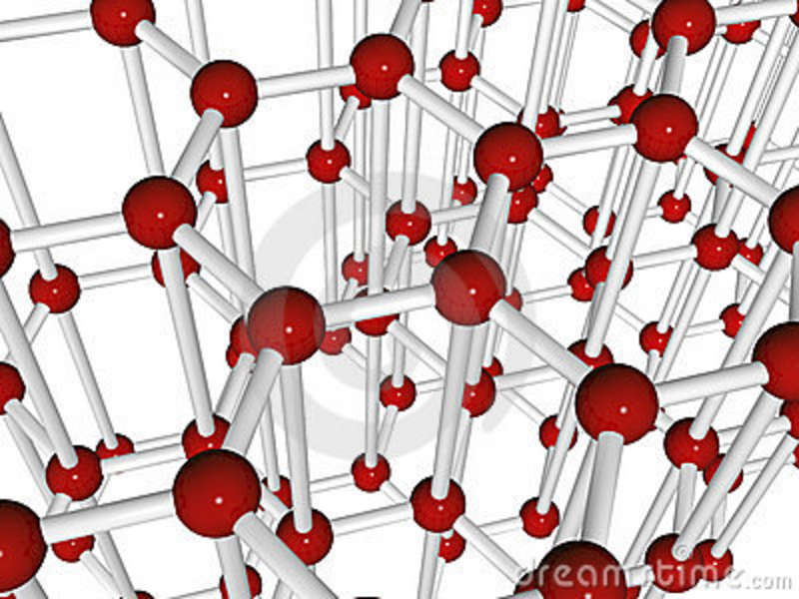
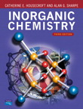

Advanced Inorganic Chemistry
CHM 403
Michael Prushan Ph.D.

Slide 2

I Inorganic

Slide 3
What’s Inorganic Chemistry??
• Organic chemistry is defined as the chemistryof hydrocarbon compounds and their derivatives
But how about CO, CO₂, and HCN…for instance?
Inorganic chemistry can be described broadly as the chemistry of “everything else”

Slide 4
Organic vs. Inorganic
•Involves few elements
• forming mostly covalent
or polar covalent bonds
• Mostly molecular solids
(except polymers)
• Usually air-stable
• Commonly soluble in
nonpolar solvents
• Distillable, crystallizable
• Bonding involves s & p
electrons
• All the elements, involving all modes of
Bonding
• Ionic, extended-network (metallic/covalent), & molecular solids
• All possibilities concerning stability with
air or water
• Widely ranging solubilities

Slide 5
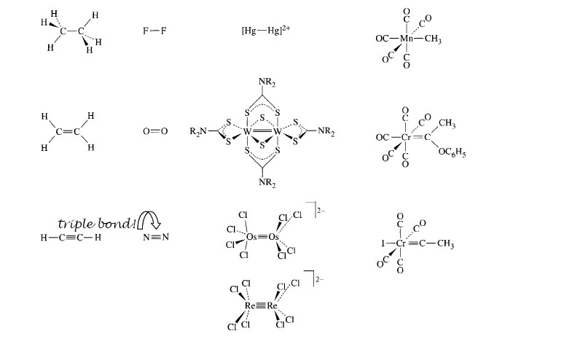
Bonding in Organic and Inorganic

Slide 6
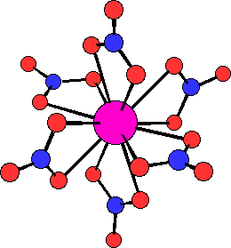
The Weird and Wacky World of
Inorganic Chemistry
Of course you can form One, Two, Three and Four Bonds, BUT that is only part of the story.…
The most common number of bonds to a transition metal ion is SIX, but that does not mitigate against larger coordination numbers. There are many compounds which contain 7,8,9 bonds to a single atom.
[Nd(NO₃)₆]³⁻

Slide 7
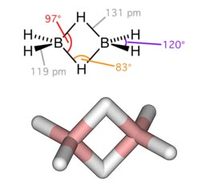

Common conceptions of bonding are not enough.
As an example, understanding the bonding in B₂H₄ .
HYDROGEN FORM HOW MANY BONDS???

Slide 8
The Elements
~ 107 of them ....
Most are metals: solids, electrical conductors,
good thermal conductors, sometimes with
high mechanical strength and ductility.
~ 22 nonmetals (As, Sb, Te, … ?)
At ambient temp.: 11 gases, 2 liquids (Br,
Hg), [+ Cs (m.p. 28.5 °C) & Ga (m.p. 29.8 °C)]

Slide 9
Abundances in Earth’s Crust
Order of occurrence (weight % abundances):
O(45.5) > Si(25.7) > Al(8.3) > Fe(6.2) >
Ca(4.66) > Mg(2.76) > Na(2.27) > K(1.84)
All others < 3% combined (including beloved Carbon and Hydrogen!)
SiO₂ and silicates are constituents of most rocks
and many “ores” of other metallic elements.
All these elements are the principal constituents of
most minerals (also important: P, S, Mn, Cr, Ti, Cu).

Slide 10
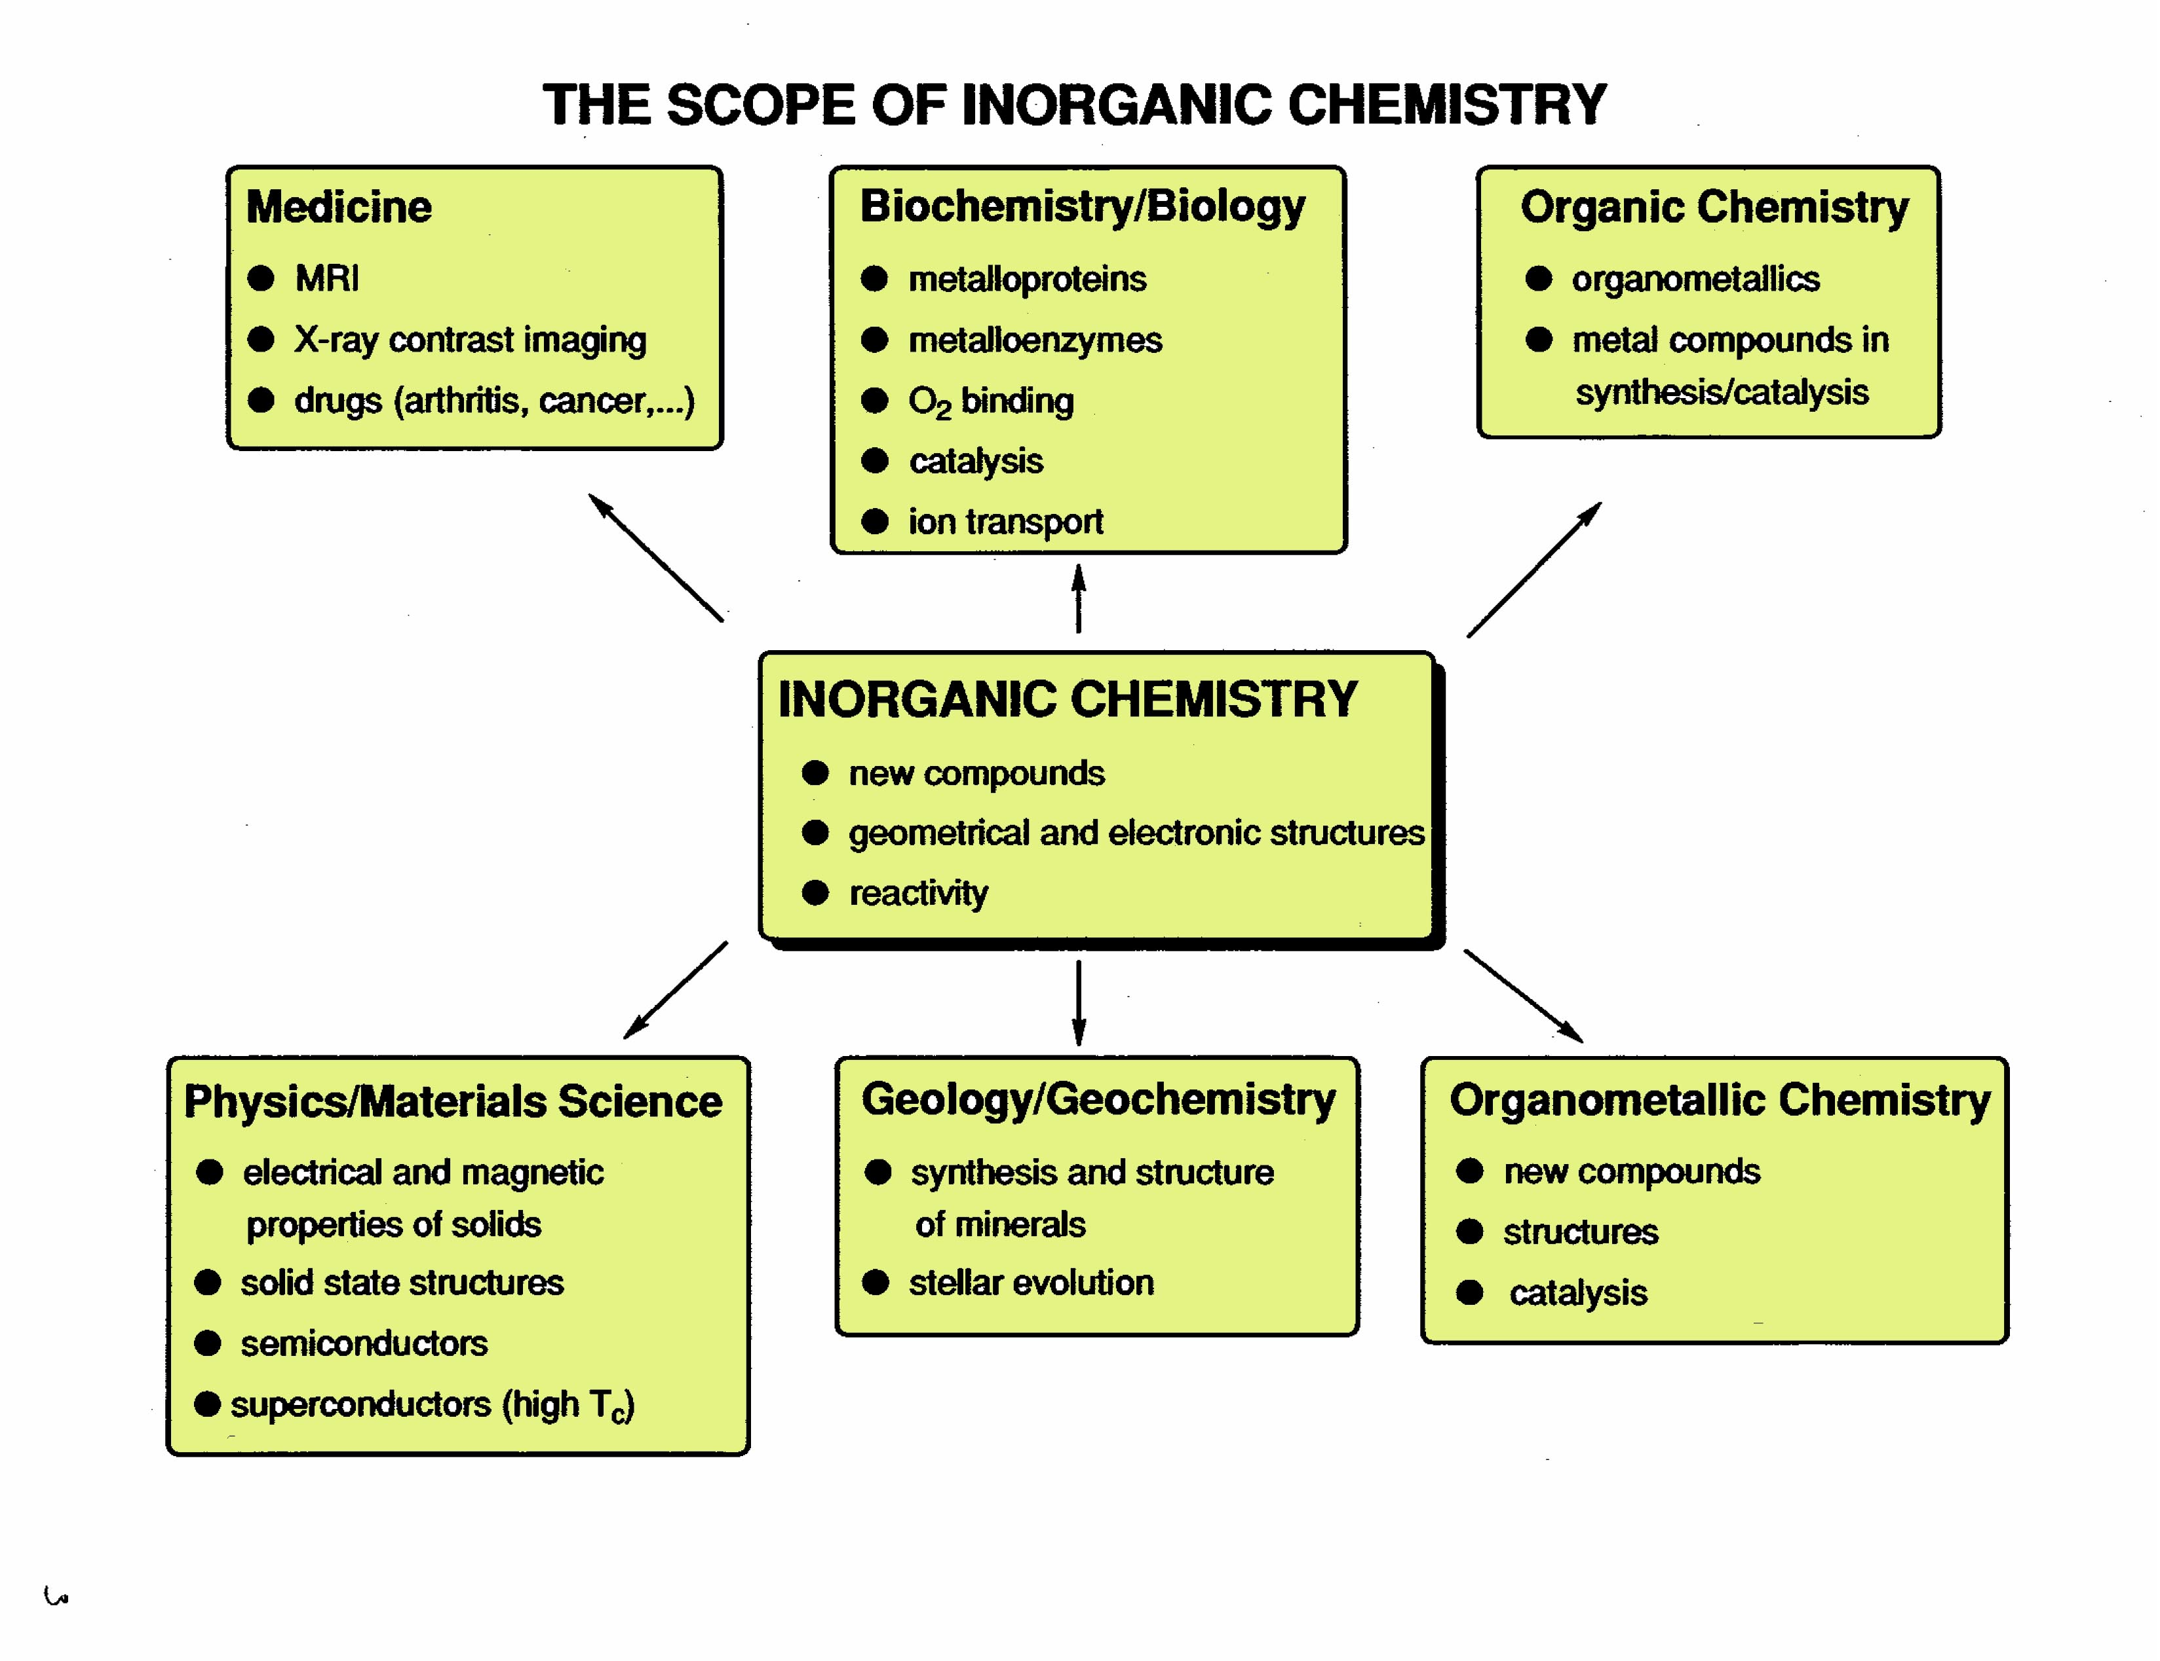

Slide 11
Medicinal Inorganic Chemistry

Slide 12
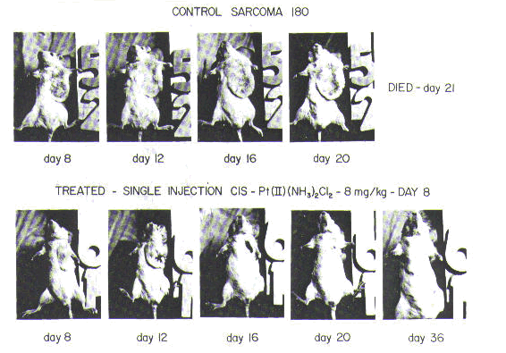

Slide 13
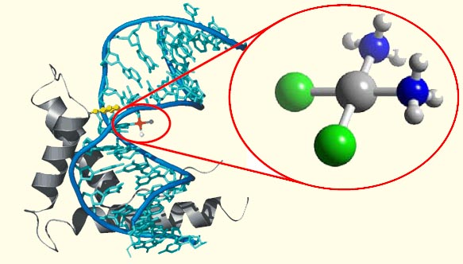

Slide 14
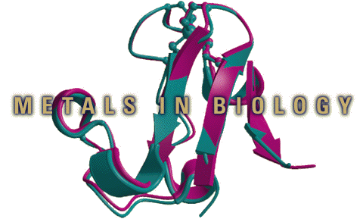
Bioinorganic Chemistry
Approximately 40 percent of all enzymes have metal ions in their active sites
The presence of the metal is what governs the reactivity of the enzyme

Slide 15
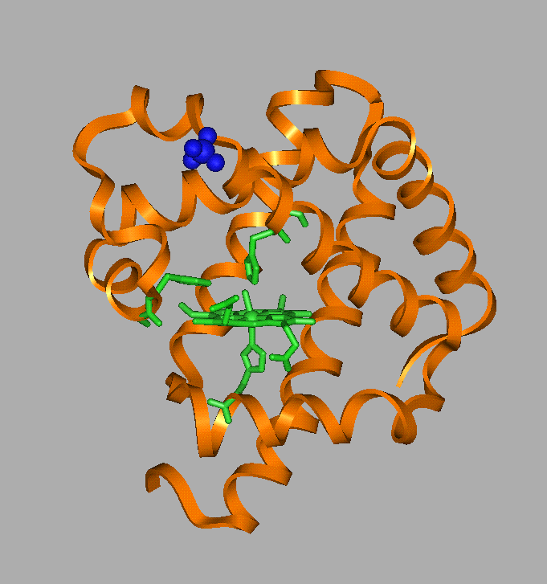
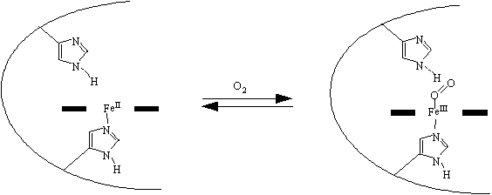
Hemoglobin and Myoglobin

Slide 16
Nitrogenase
Catalyzes the “nitrogen” fixation process in plants.
N₂ + 8H⁺ + 8e⁻ + 16 ATP → 2NH₃ + H₂ + 16 ADP + 16 PO₄³⁻

Slide 17
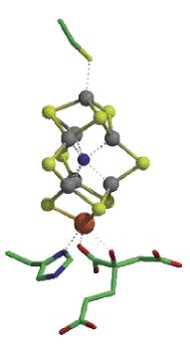
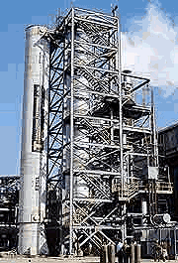
Industrial
Plants
500 ºC , 200 atm pressure
20 ºC, 1 atm pressure

Slide 18
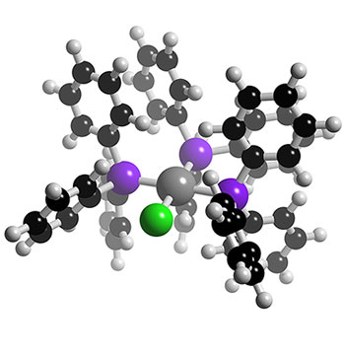
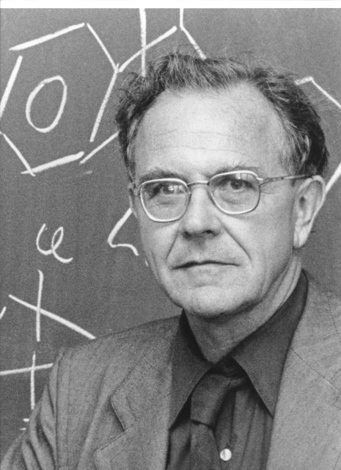
Organometallic Chemistry
catalysis
Sir Geoffrey Wilkinson
Nobel Prize 1973

Slide 19
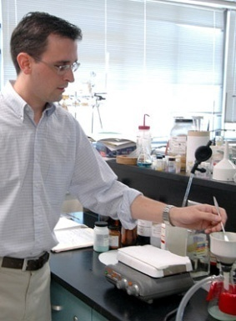

Kevin Bacon and Inorganic Chemistry
Or something like that
Robert Gillard

Slide 20
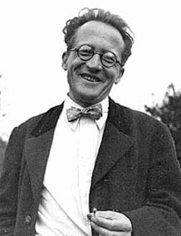
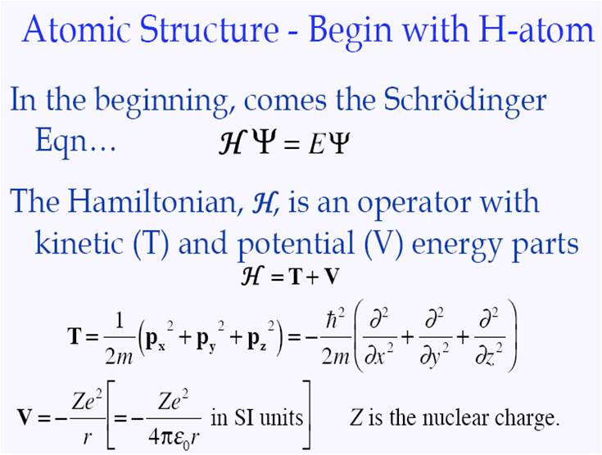
So to start we need ATOMS and to explain them
we need QUANTUM MECHANICS
At the heart of it all is the Schrödinger Equation
I
Eψ = H ψ

Slide 21
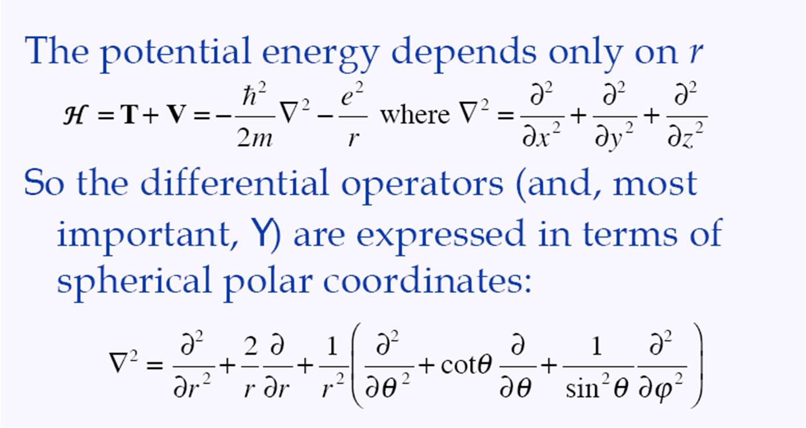
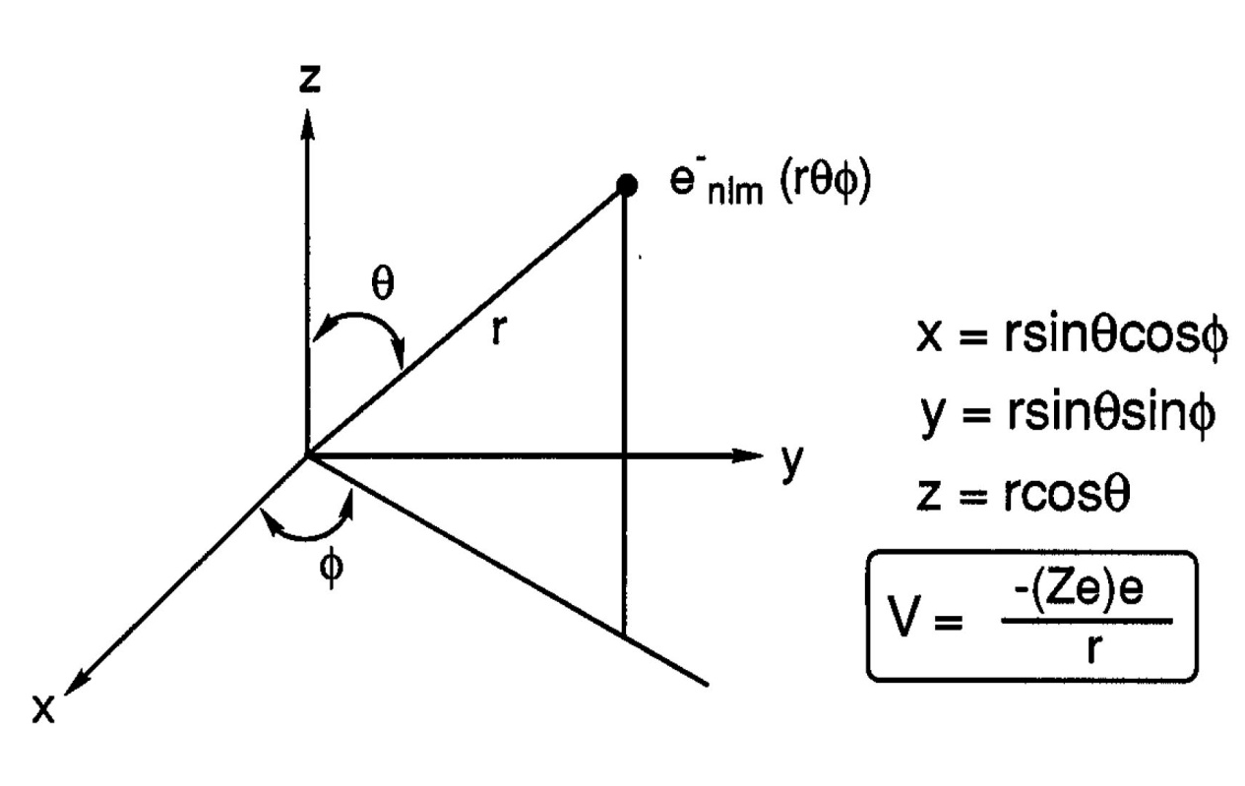
Electrons in atoms
We’ll see this is
true a bit later!
Chemists care mostly about the electrons in atoms (Nuclei are important too)
Electrons reside in orbitals in atoms….. And atoms are spheres so…
The math is done in spherical polar coordinates

Slide 22
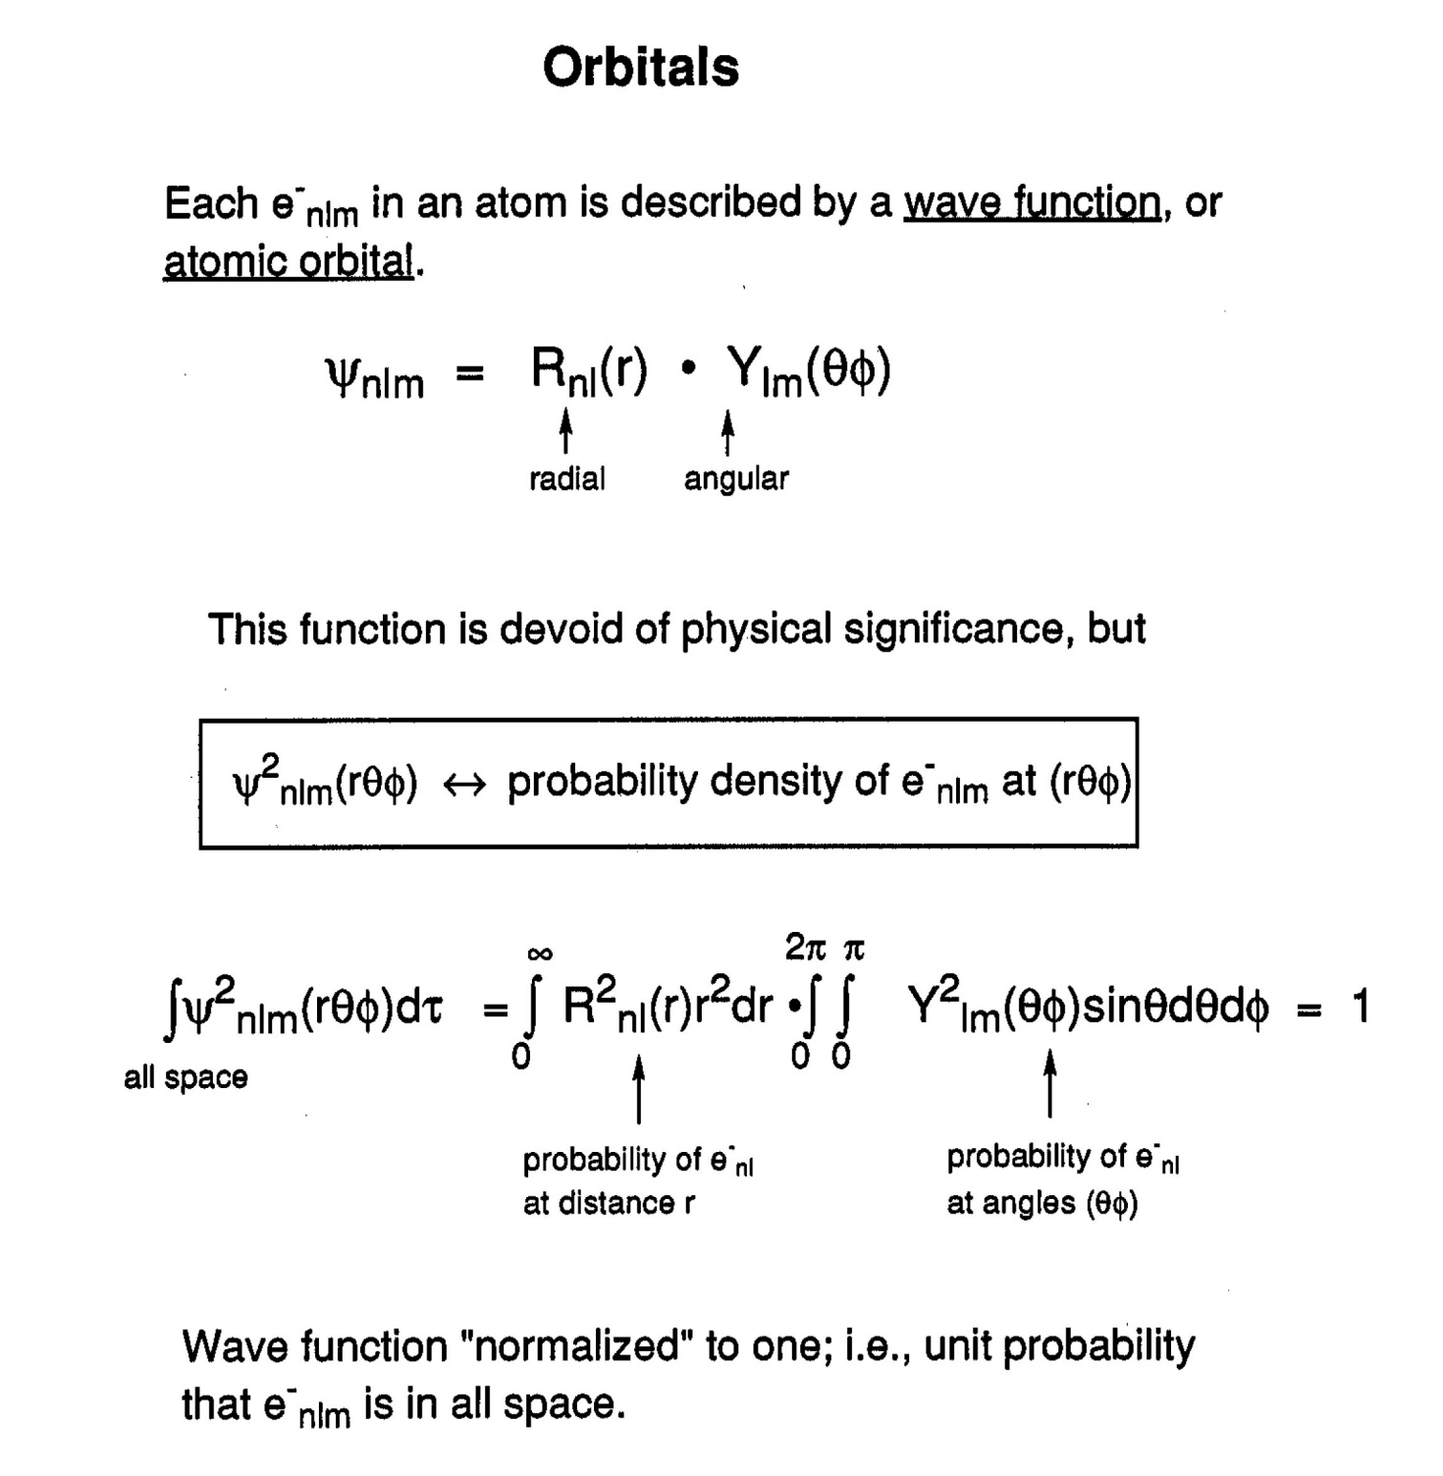
But orbitals aren’t just where the electrons live, they’re SO much more…
Each electron (e_{nlm} ⁻) in an atom is described by a wavefunction a.k.a. atomic orbital
Everything
distance
shape
The wavefunction is devoid of physical significance, but

Slide 24
Principal Quantum Number: n
n = 1, 2, 3 ... ∞
• determines ENERGY and SIZE of orbital
electrons with the same value of n are in the same energy “shell”
(Azimuthal) Angular Quantum Number: l
l = 0, 1, 2 ... n–1
• determines SHAPE/TYPE of orbital (mainly)
l = 0 ⇒ s
l = 1 ⇒ p
l = 2 ⇒ d
l = 3 ⇒ f
• electrons with the same value of l are in the same energy “subshell”

Slide 25
Magnetic Quantum Number: m_{l}
m_{l} = 0, ±1, ±2 ... ± l
• determines ORIENTATION of an orbital, and number of orbitals in each shell/subshell (mainly)
if l = 0, m_{l} = 0: only one s orbital for each value of n
if l = 1, m_{l} = 0, ±1: three p orbitals for each value of n
if l = 2, m_{l} = 0, ±1, ±2: five d orbitals for each value of n
if l = 3, m_{l} = 0, ±1, ±2, ±3: seven f orbitals for each value of n

Slide 26
for n = 1, one orbital, Ψ _{n,l,m} = Ψ₁₀₀ (1s)
for n = 2, four orbitals, Ψ₂₀₀ (2s), Ψ₂₁₀ (2p_{z}), Ψ_{21±1} (2p_{x} and 2p_{y})
for n = 3, nine orbitals, Ψ₃₀₀ (3s), Ψ₃₁₀ (3p_{z}), Ψ_{31±1} (3p_{x} and 3p_{y}),
Ψ₃₂₀ (3d_{z}²), Ψ_{32±1} (3d_{xz} and 3d_{yz}), Ψ_{32±2} (3d_{xy} and 3d_{x}²_{–y}²)
• Thus, for a given value of n, there are n subshells and a total of n² orbitals in the shell.

Slide 27
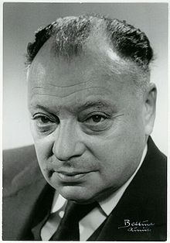
Spin Quantum Number: m_{s}
m_{s}= ±1/2
no two electrons in a single atom can have the same four quantum numbers
• 4th Quantum number, used to distinguish each electron with the the same n, l and m_{l} values.
What is spin any way?
One of the two types of angular momentum in atoms (orbital AM is the other)
Spin is a “type” of angular momentum that exists, but for which there is no classical analog. Behaves like a spinning top, but only has two values (for electrons ±1/2) The spin of an elementary particle is an intrinsic physical property, akin to the particle's electric charge and mass.
Fermions are subatomic particles with half-integer spin : Quarks and leptons (including electrons and neutrinos), which make up what is classically known as matter, are all fermions with spin-1/2. The common idea that "matter takes up space" actually comes from the Pauli exclusion principle acting on these particles to prevent the fermions that make up matter from being in the same quantum state.

Slide 29
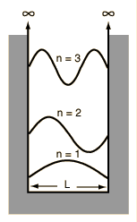
Remember the particle in a box?
One important phenomenon that resulted
Was the development of nodes as n increased.
This is true for all wavefunctions in
quantum mechanics
So it’s true for atoms as well

Slide 32
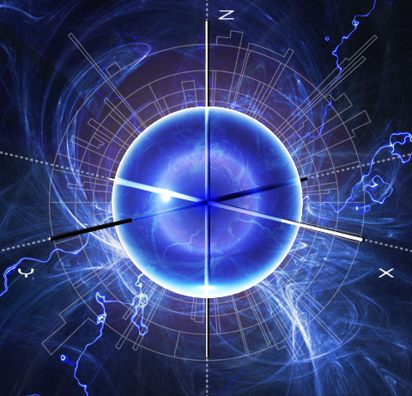
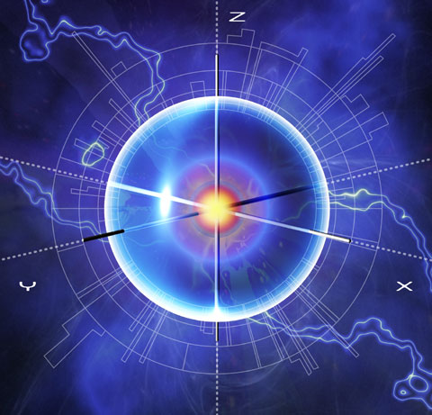
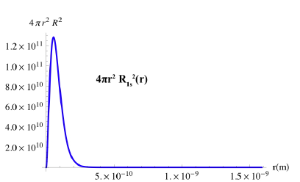
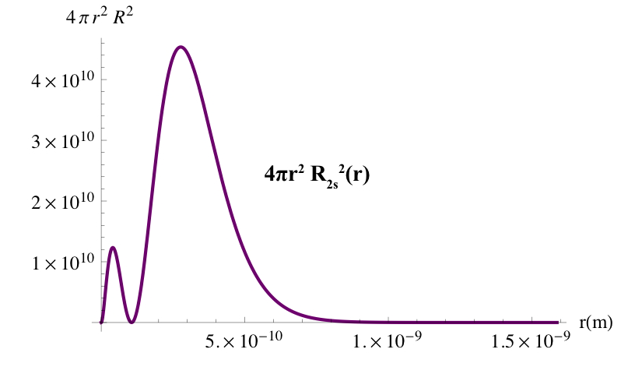
1s
2s

Slide 34
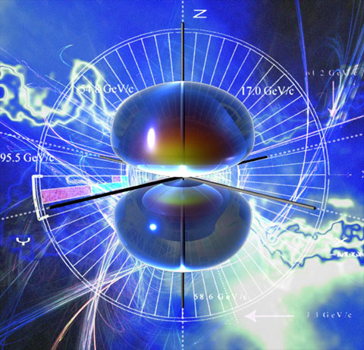
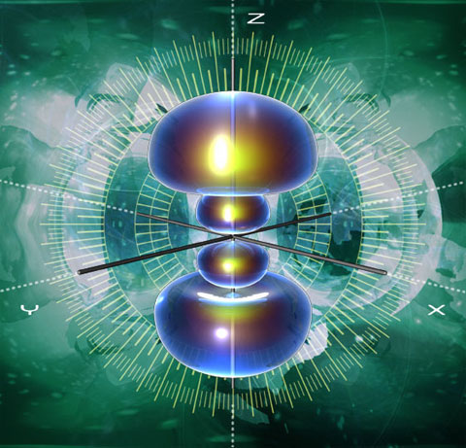
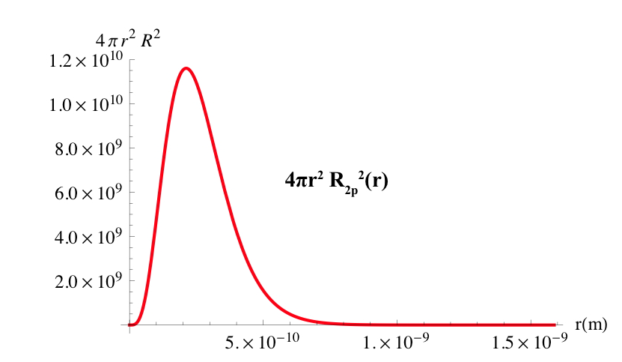
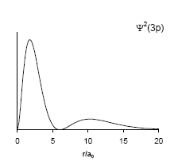
3p_{z}
2p_{z}

Slide 35
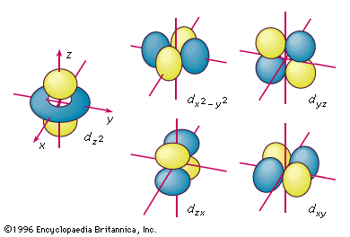
3 d orbitals
Check out
THE ORBITRON

Slide 36
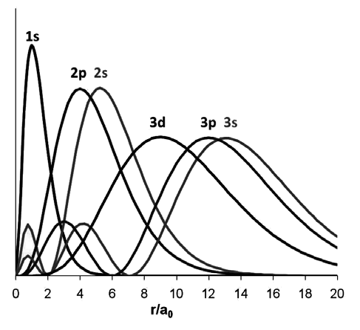
Overlay of Radial Distribution Functions 4πr²R(r)² for the hydrogen atom
ns orbitals have (n-1) radial nodes
np orbitals have (n-2) radial nodes
n d orbitals have (n-3) radial nodes
n f orbitals have (n-4) radial nodes

Slide 37
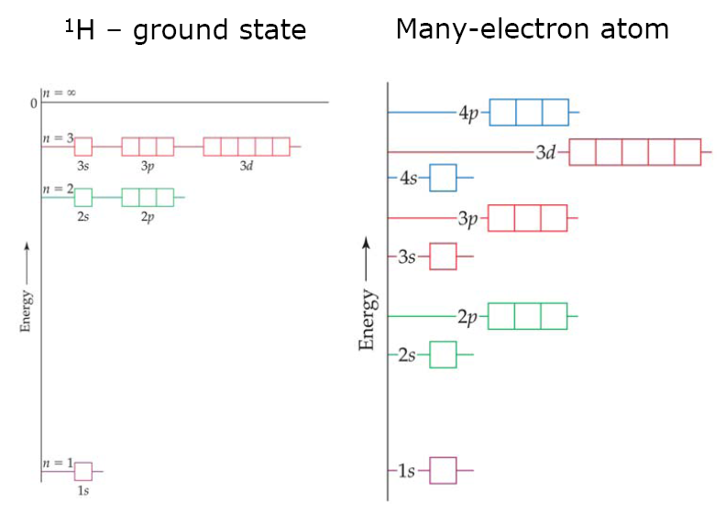
In multi-electron atoms, orbital energy depends on both the shell (n) and the subshell (l) as well as from a higher Z---a stronger pull from the nucleus.
.

Slide 38
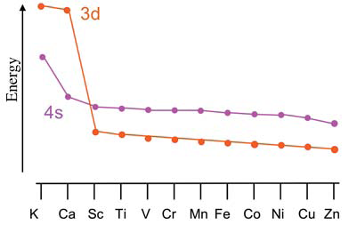
Electron Configuration
The relative energies of orbitals in neutral atoms:
1s < 2s < 2p < 3s < 3p <4s < 3d < 4p< 5s < 4d <5p < 6s <5d≈4f < 6p <7s < 6d≈5f
The aufbau (“building up”) principle: orbitals are filled in the order of energy, the lowest energy orbitals being filled first.
ELECTRON CONFIGURATIONS OF IONS -NOT THE SAME AS NEUTRALS!!! Once a d orbital is filled, the orbital energy drops to below the corresponding
s orbital.
Ti [Ar]4s²3d²
Ti²⁺ [Ar] 3d²

Slide 39
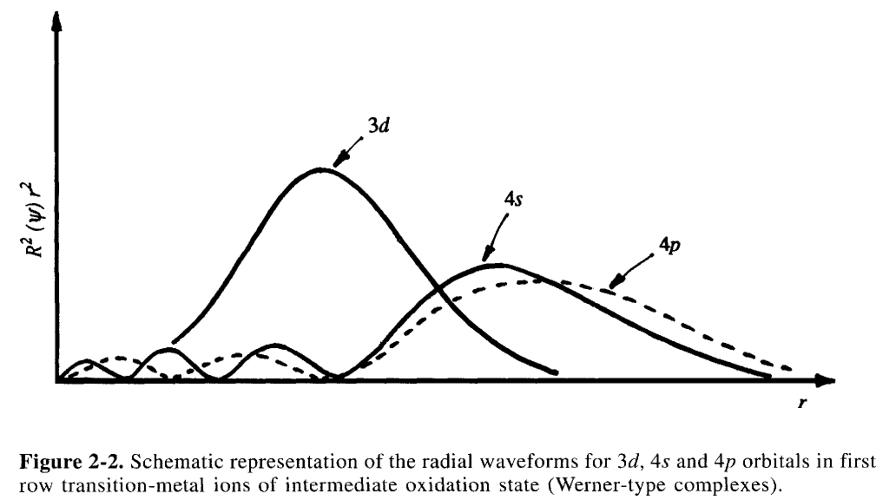

Slide 40
Pauli Exclusion Principle : no two electrons in the same atom can have identical sets of quantum numbers n, l, m_{l}, m_{s}; each orbital can accommodate a maximum of two electrons with different m_{s}.
NOT ALLOWED !
Hund’s (first) rule: in a set of degenerate orbitals, electrons may not be spin paired in an orbital until each orbital in the set contains one electron; electrons singly occupying orbitals in a degenerate set have parallel spins, i.e. have the same values of m_{s}
Maximize the spin multiplicity (2s+1) to minimize e⁻- e⁻ repulsions
Lower Energy
Multiplicity [2(3/2)+1] = 4 (quartet)
N 1s²2s²2p³
Multiplicity [2(1/2)+1] = 2 (doublet)

Slide 41
Oxidation States from configurations
Ca [Ar] 4s² Ca²⁺
Sc[Ar] 4s²3d¹ Sc²⁺
Ti [Ar] 4s²3d² Ti²⁺, Ti⁴⁺
V [Ar] 4s²3d³ V²⁺, V4⁴⁺, V⁵⁺
Cr [Ar] 4s²3d⁴ but actually [Ar] 4s¹3d⁵ predict Cr⁺ (but doesn’t exist)
Cr²⁺ , Cr³⁺, Cr⁶⁺
½ filled d shell
Increased stability
blue
green
orange, yellow
Mn [Ar] 4s²3d⁵ Mn⁺²
Cu [Ar] 4s²d⁹ but actually [Ar] 4s¹3d¹⁰ predict Cu⁺ (yes)
Cu²⁺
blue
Cr and Cu are exceptions to the aufbau principle
Filled d shell
Increased stability

Slide 42
Nuclear Charge (Z) and Shielding
As Z increases, expect Energy (ionization energy) to increase
H 1312 kJ/mol Z=1 1s¹
Li 520 kJ/mol Z=3 1s²2s¹
What causes the difference?
2s¹ electron in Li is further from the nucleus
1s² electrons repel 2s¹ electron
3. 2s¹ electron is shielded from core (3+) by 1s² electrons
Z* = effective nuclear charge = Z-S
Where Z is the nuclear charge and S is shielding constant
USE SLATER’S RULES TO CALCULATE Z*
s orbitals are more penetrating (good at shielding)
d orbitals are less penetrating, diffuse (poor at shielding

Slide 43
SLATER’S RULES
Shielding and effective nuclear charge Z*:
Z* = Z – S (a measure of the nuclear attraction for an electron)
To determine S (Slater’s rules):
Write electronic structure in groups as follows:
    (1s) (2s, 2p) (3s, 3p) (3d) (4s, 4p) (4d) (4f) (5s, 5p) etc.
Electrons in higher groups (to the right) do not shield those in lower groups
For ns or np valence electrons:
other electrons in the same n group: 0.35; except for 1s where 0.30
is used.
electrons in the n-1 group: 0.85
electrons in the n-2, n-3,… groups: 1.00
For nd and nf valence electrons:
other electrons in the same nd or nf group: 0.35
electrons in groups to the left: 1.00
S is the sum of all contributions

Slide 44
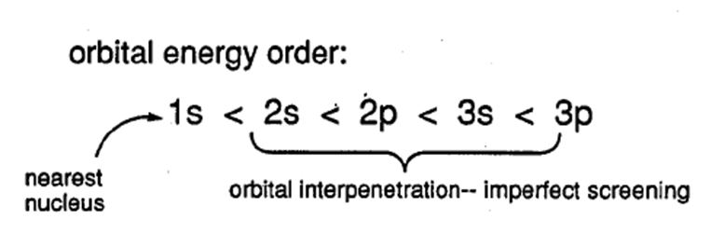
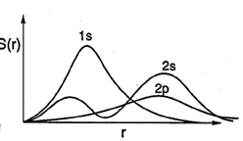

Slide 46
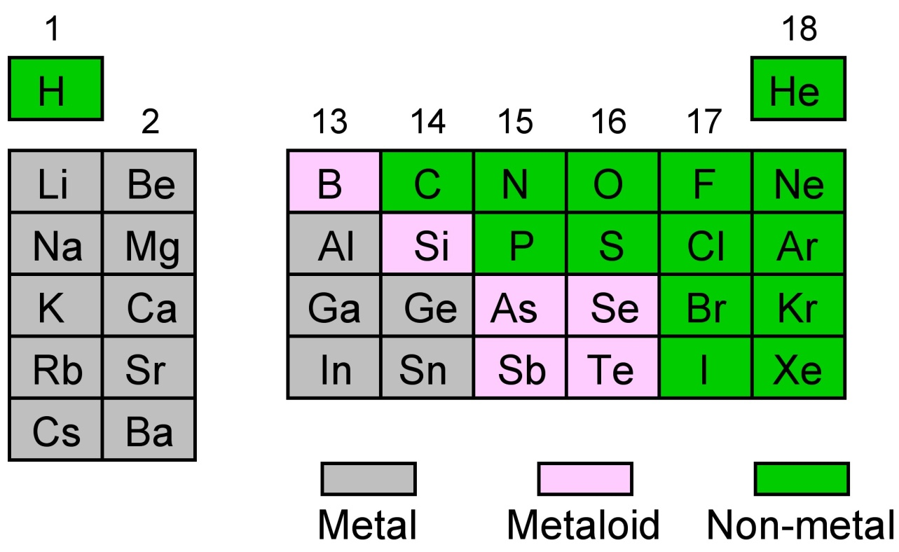
Periodic trends
Periodic trends: are related to the numbers and types of valence electrons and the effective nuclear charge (Z*)
Let’s look at the main group elements first without worrying about
those pesky d and f orbitals

Slide 47
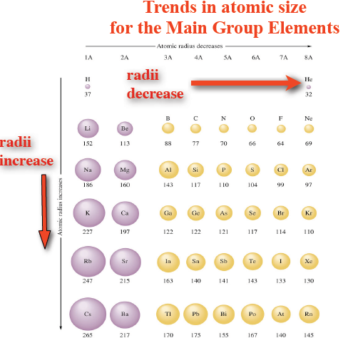

Slide 48
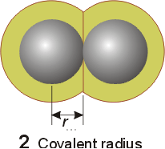
How do you measure the radius of an atom anyway?
Atoms are not perfect spheres with defined limits !!
Atomic radii are generally definied as the covalent radii
covalent radius (half the distance of the bond) or 1/2(dAA in the A2 molecule)
Example:
H₂: d = 0.74 Å ; so r_{H} = 0.37 Å
To estimate covalent bond distances e.g.:
R----C-H: d C-H = rC + rH = 0.77 + 0.37 =1.14 Å

Slide 49
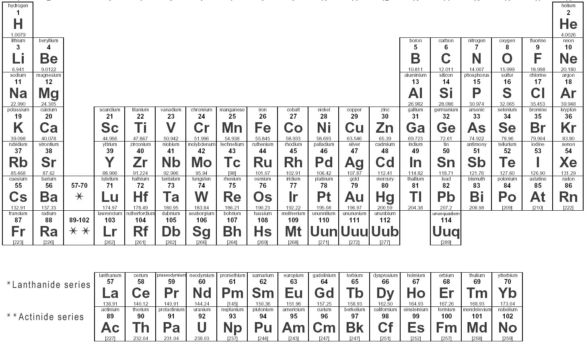
Periodic Trends and Z*
As n increases, atomic radius increases
As Z* increases, atomic radius decreases
Predictions of periodic trends
1. Atoms in the same group increase in size from top to bottom
Slater Z* Radius (Å)
H 1.0 0.37
Li 1.3 1.52
Na 2.2 1.86
K 2.2 2.31
Z* is not changing much,
n determines size here

Slide 50
Periodic Trends and Z*
2. Atoms in the same period (across from left to right) decrease in size
Slater Z* Radius (Å)
Li 1.30 1.52
Be 1.95 1.11
B 2.60 0.88
C 3.25 0.77
N 3.90 0.70
O 4.55 0.66
F 5.20 0.64
Ne 5.85 0.70
Z* increases steadily, electrons are being added to the
Same shell (poor shielding)

Slide 51
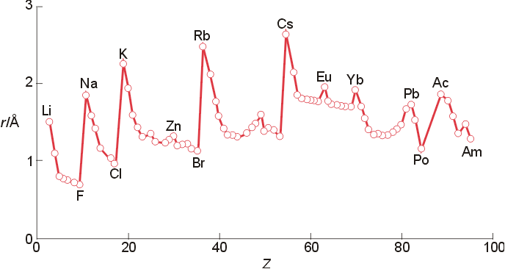
The size of orbitals tends to grow with increasing n.
As Z increases, orbitals tend to contract, but with increasing number of electrons mutual repulsions keep outer orbitals larger
1. Atomic radii increase on going down a group
(Z_{eff} ~ constant as n increases because of shielding).
2: Atomic radii decrease along a period
(Z_{eff} increases and n is constant)

Slide 52
Periodic Trends and Z*
The exceptions : The transition metals (that’s what makes them interesting!)
Expect Ga > Al but Al 1.30 Å
Ga 1.20 Å
Expect Ge > Si but Si 1.18 Å
Ge 1.22 Å
For Ga and Ge, the d-orbitals are poor shielders, therfore the valence electrons feel more Z and are pulled closer
Fe 1.25 Å | Co 1.26 | Ni 1.21 | Cu 1.35
Ru 1.33 | Rh 1.32 | Pd 1.31 | Ag 1.52
Os 1.33 | Ir 1.32 | Pt 1.31 | Au 1.40
Expect Pt > Pd but Pd 1.31 Å
Pt 1.31 Å
Ni<Pd=Pt
3rd row transition metals have a inner filled f shell which are worse shielders, so atoms contract.
The Lanthanide Contraction

Slide 53
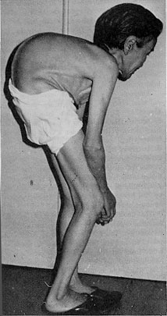
Itai-itai disease
Literal translation: “it hurts-it hurts” disease
Documented case of mass cadmium poisoning Japan, starting around 1912. The cadmium poisoning caused softening of the bones especially in the joints and spine which causes severe pain and kidney failure.
The cadmium was released into rivers by mining companies in the mountains. The mining companies were successfully sued for the damage
Expect Cd²⁺ to be larger that Ca²⁺ , both are 140 pm in radius due to the poor shielding capabilities of the d orbital (diffuse) electrons.

Slide 54
Ionization energy
Ionization energy (potential) is the energy needed to remove an electron from an atom or +ion in the gas phase.
1: IE₁ decreases on going down a group ( n, r increases and Z_{eff} is constant).
2: IE₁ increases along a period (Z_{eff} increases, r decreases)
Exception: Half-filled or filled shell are particularly stable
B ([He]2s²2p¹ → [He]2s²) lower IE than Be ([He]2s² → [He]2s¹),
O ([He]2s²2p⁴ → [He]2s²2p³) lower IE than N ([He]2s²2p³ → [He]2s²2p²)
Similar for: Al, S

Slide 55
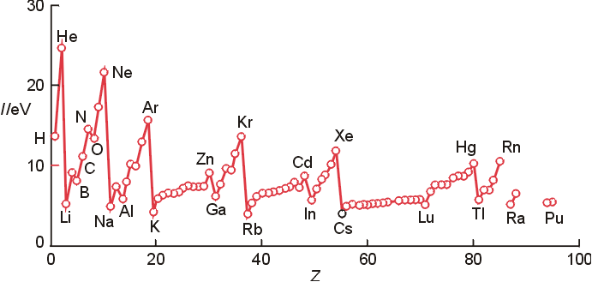
Ionization energy
1: IE₁ decreases on going down a group ( n, r increase and Z_{eff} is constant).
2: IE₁ increases along a period (Z_{eff} increases, r decreases)
Maximum for noble gases
Minimum for H and alkali metals

Slide 56
Electron affinity (EA)
measured as energy required to remove an electron from a gaseous negatively charged ion (ionization energy of the anion) to yield neutral atom.
  Maximum for halogens
  Minimum for noble gases
  Much smaller than corresponding IE

Slide 57
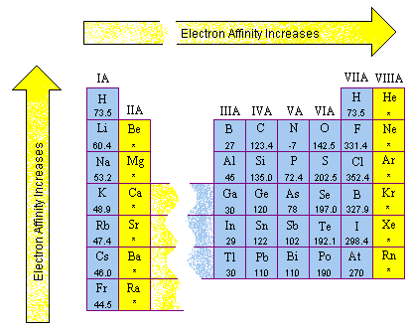

Slide 58
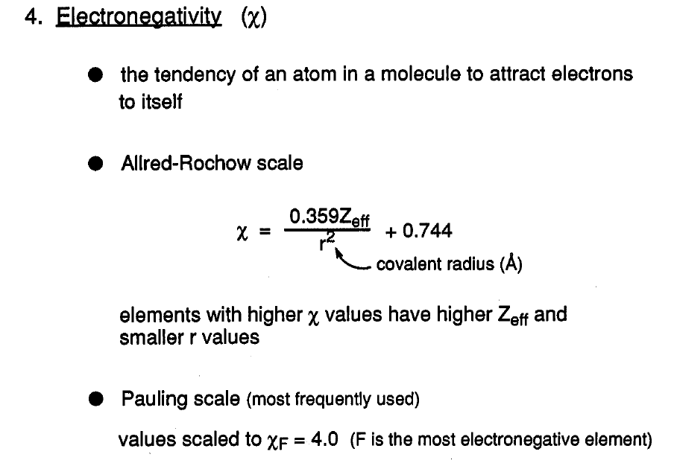

Slide 59
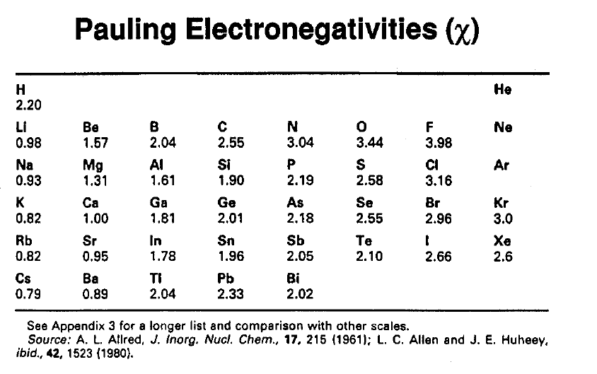

Slide 60
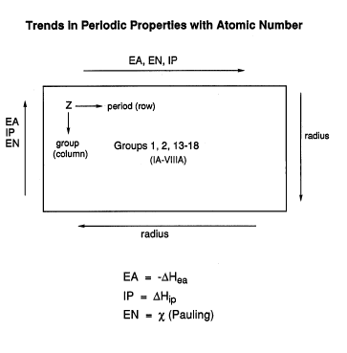

Slide 61
What about REDOX properties?
Where in the periodic table would you expect to find the strongest reductants (reducing agents)?
Reductants donate electrons to oxidants
Where in the periodic table would you expect to find the strongest oxidants (oxidizing agents)?
Strongest oxidizing agent
(easiest to reduce)
Most electronegative
Oxidants have strong affinities for electrons
Strongest reducing agent
(easiest to oxidize)
Least electronegative

Slide 62
More difficult to oxidize
Strongest oxidizing agent
(easiest to reduce)
Ease of oxidation
Strongest reducing agent
(easiest to oxidize)
Ease of oxidation

Slide 63
Easier to oxidize
(Eº decreases)
Easier to oxidize (Eº decreases)

Slide 64
Reduction potential and periodic trends
The more negative the easier to oxidize
Be²⁺ + 2 e⁻ Be(s) -1.968 v vs. SHE
Ba²⁺ + 2 e⁻ Ba(s) -2.906 v
Al³⁺ + 3e⁻ Al(s) -1.677 v
Sc⁺³ + 3 e⁻ Sc(s) -2.08 v
Ti⁺² + 2 e⁻ Ti(s) -1.60 v
V⁺² + 2 e⁻ V(s) -1.125 v
Cr⁺² + 2 e Cr(s) -0.89 v
Mn⁺² + 2 e⁻ Mn(s) -1.182 v
Fe⁺² + 2 e⁻ Fe(s) -0.44 v
Co⁺² + 2 e⁻ Co(s) -0.282 v
Ni⁺² + 2 e⁻ Ni(s) -0.236 v
Cu⁺² + 2 e⁻ Cu(s) +0.339 v
Zn⁺² + 2 e⁻ Zn(s) -0.762 v
Ag⁺ + e⁻ Ag(s) +0.799 v
Au⁺ + e⁻ Au(s) +1.69 v
?

Slide 65
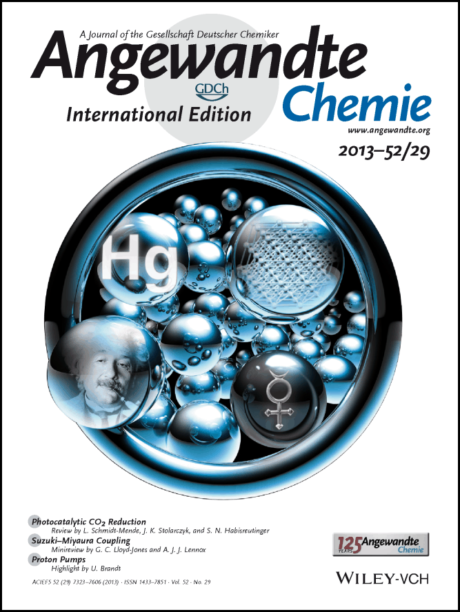
Why is mercury a liquid?
Comparing properties of Hg with Au
m.p. of Au is 1064 ºC
m.p. of Hg is -39 ºC
Conductivity
Au 426 kSm⁻¹
Hg 10.64 kSm⁻¹
July 2013
These and many other properties can not be explained by the
Lanthanide contraction, etc.

Slide 66

Relativistic Effects
In 1905 Einstein discovered special relativity, which states that the
mass of any moving object increases with its speed.
Neils Bohr calculated the speed of a 1s electron in a H-atom in the ground state
to be 1/137 the speed of light. This speed is so low that the relativistic mass is only
1.00003 times the rest mass.
BUT
When we move to the heavy elements like ⁷⁹ Au or ⁸⁰ Hg, things change.
The expected radial velocity of a 1s electron in atoms
Heavier than hydrogen is:
So for Hg, (80/137)• c = 0.58c or 58 % of the speed of light!
This in turn shrinks the 1s orbital radius by 23 %. The 1s orbitals dramatically shrinks. All other orbitals must do the same, to remain orthogonal .

Slide 67
Relativistic Effects
Hg(I) only exists as Hg₂²⁺ isoelectronic with Au₂
Hg(0) does not form strong covalent bonds with itself like gold.
The shrinking of the orbitals decreases so much that the 6s electrons are not available to form bonds.
Hg(0)-Hg(0) does not exist.
In the gas phase, Hg is the only metal that exists as a monomer, gold forms stable Au₂ (g)
Analogous to H₂(g) vs. He(g)
This property also explains why the conductivity is so low. The 4s electrons are very localized and can not
Populate the conductance band very well.

